Slide 1
Binary Heap

Slide 2
Introduction
A tree with specific properties
A complete tree. All level filled except the last level.
It can be stored as a simple array data structure
It’s a min or a max Heap. Min mean that the root is the minimum value. Max the root is the maximal value.
In this document we refer to the min version.

Slide 3
Applications
Heap Sort, slower in practice than a quicksort but has a worst case of O(n log n) compared to O(n²) for quicksort.
Priority queue
Graph algorithm like Dijkstra's

Slide 4
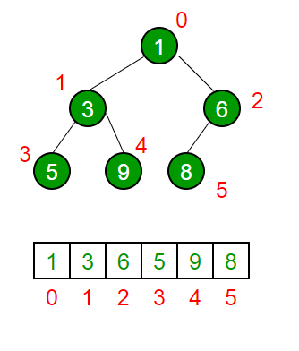
Data structure
The rules are as follow.
Root is at index 0
Parent node index is (currentIndex-1)/2
Left Child index is (2*i) + 1
Right Child : (2*i) + 2
Parent is always lower or equal in value than it’s children
Tree cannot have hole.

Slide 5
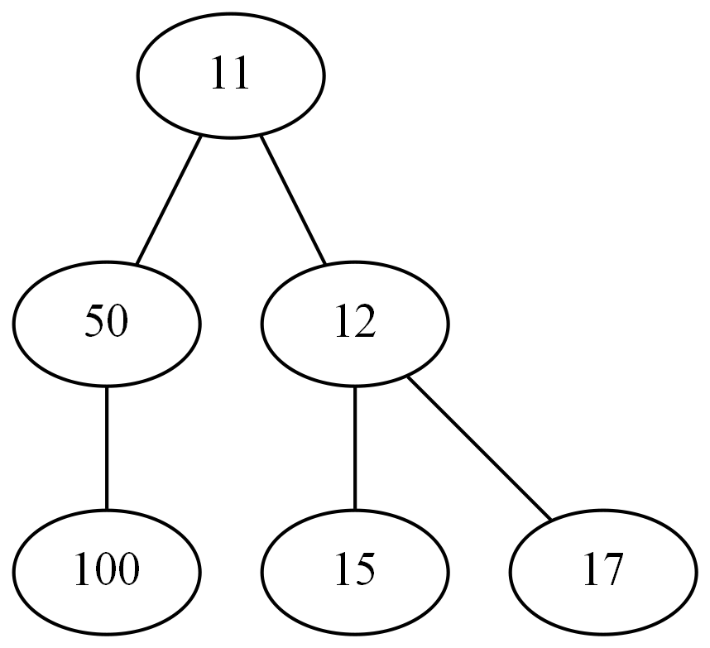
Exercises – Is this Tree Valid?

Slide 6
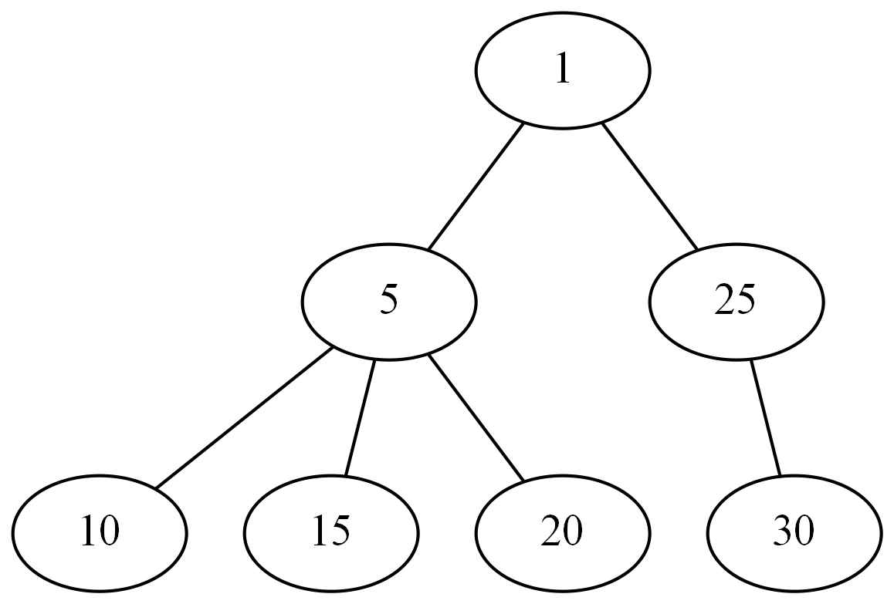
Exercises – Is this Tree Valid?

Slide 7
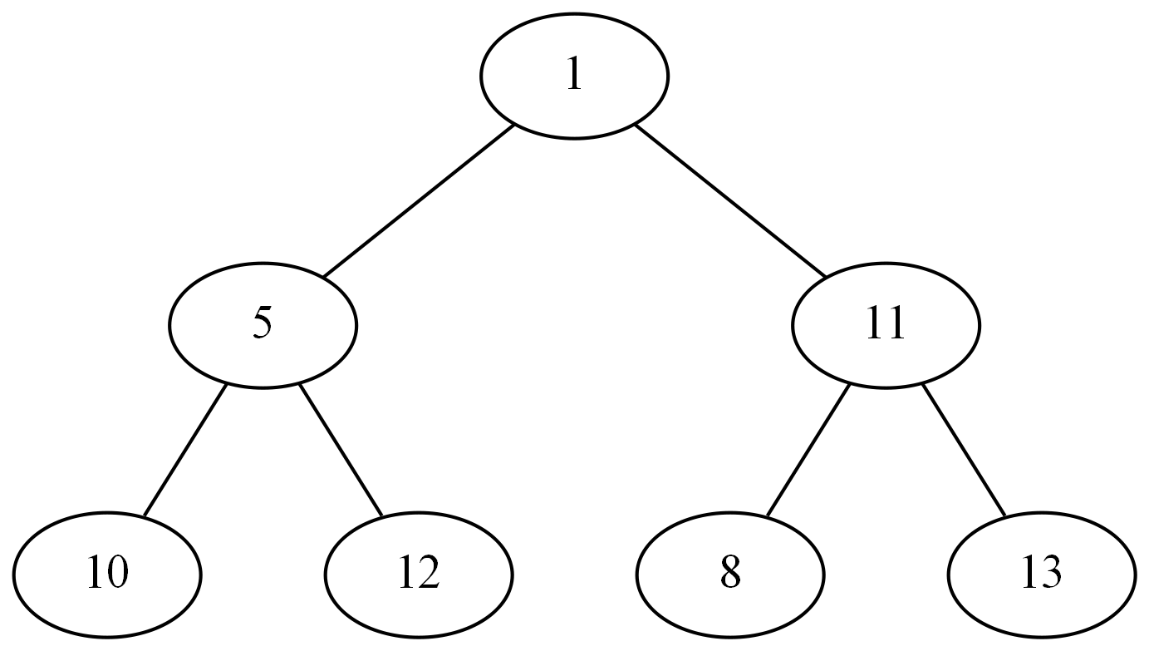
Exercises – Is this Tree Valid?

Slide 8
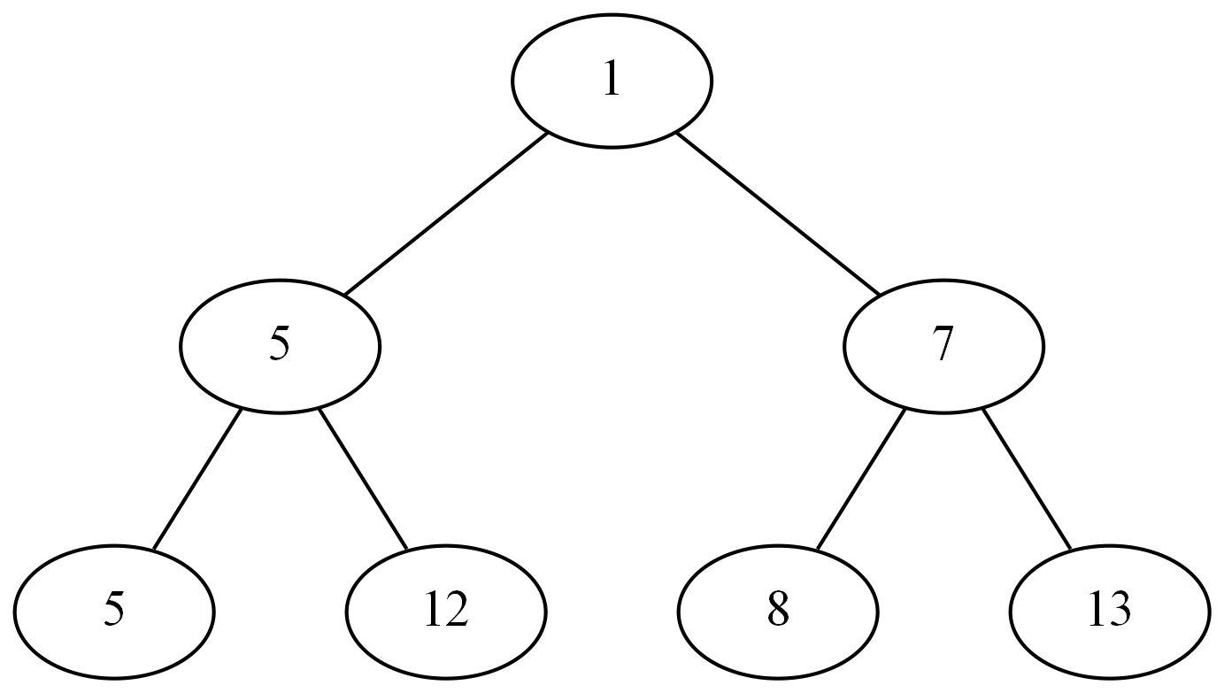
Exercises – Is this Tree Valid?

Slide 9
Operations
GetMin() O(1)
ExtractMin() O(logn)
Insert() O(logn)
Delete() O(logn)

Slide 10
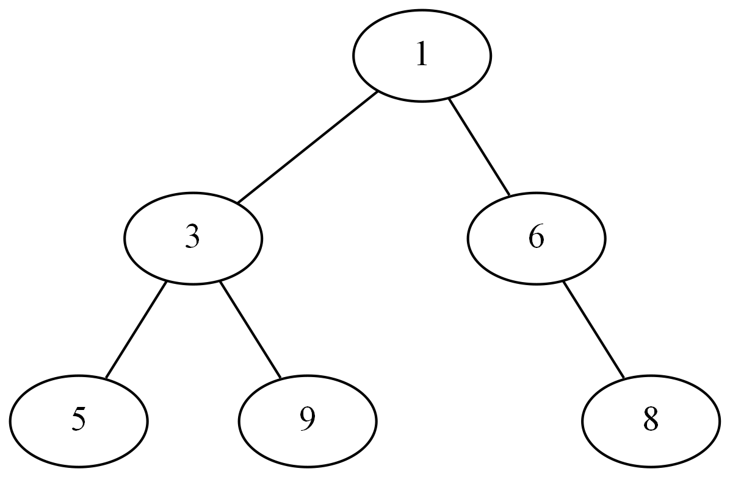
Example 1 – Adding an element

Slide 11
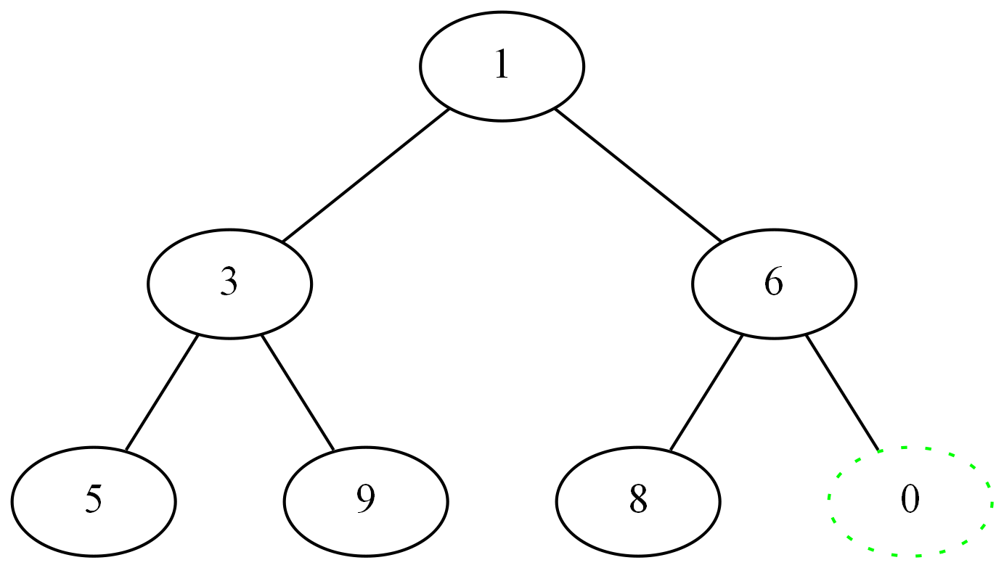
Example 1 – Adding an element

Slide 12
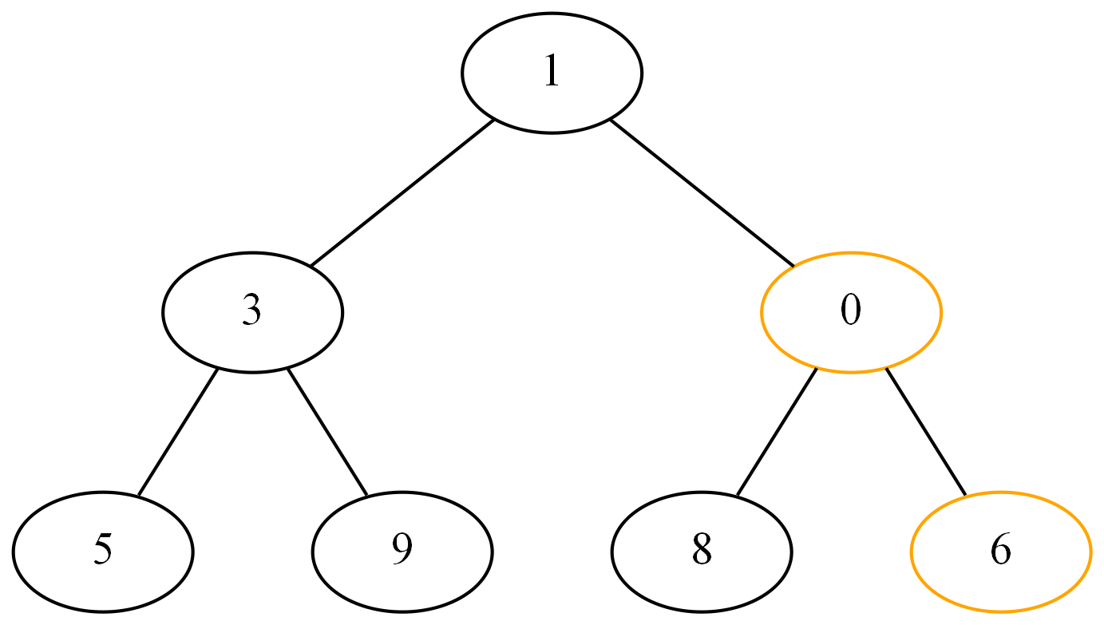
Example 1 – Adding an element

Slide 13
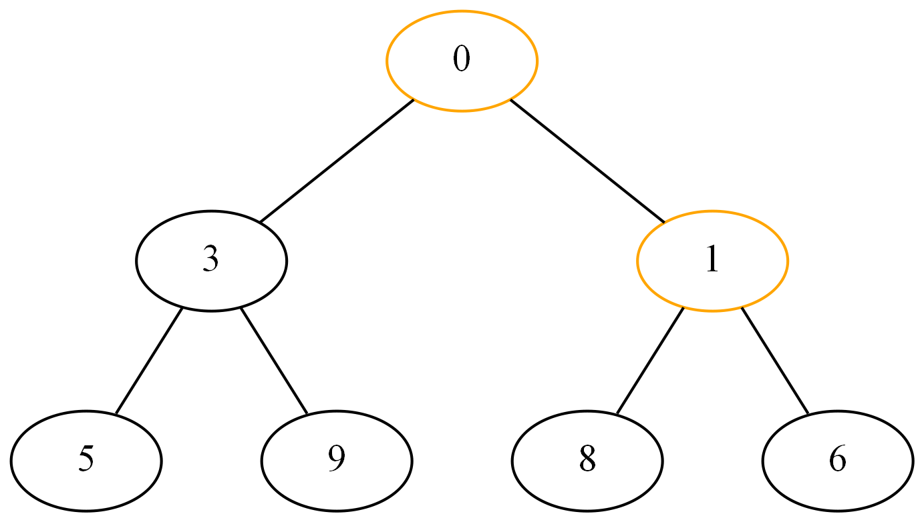
Example 1 – Adding an element

Slide 14
Example 2 – Removing the root
Move last element at root
Trickle down that element until it has no child with lower value

Slide 15
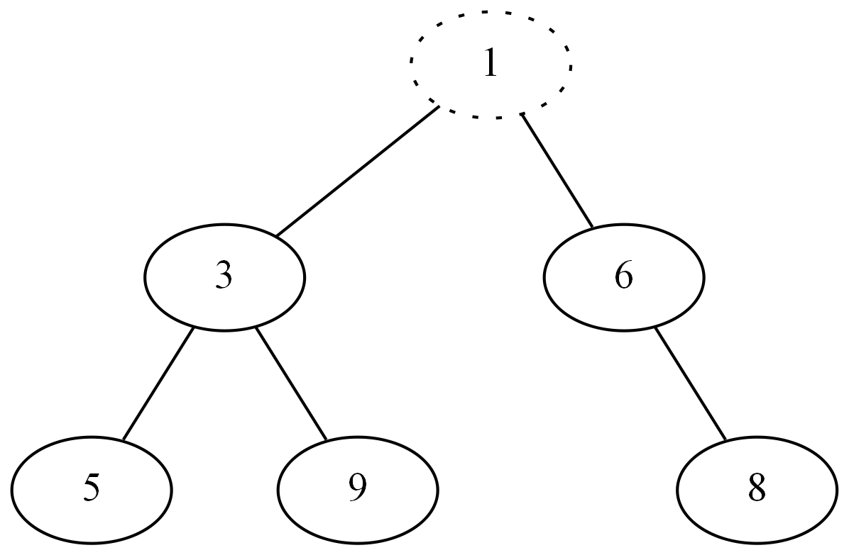
Example 2 – Removing the root

Slide 16
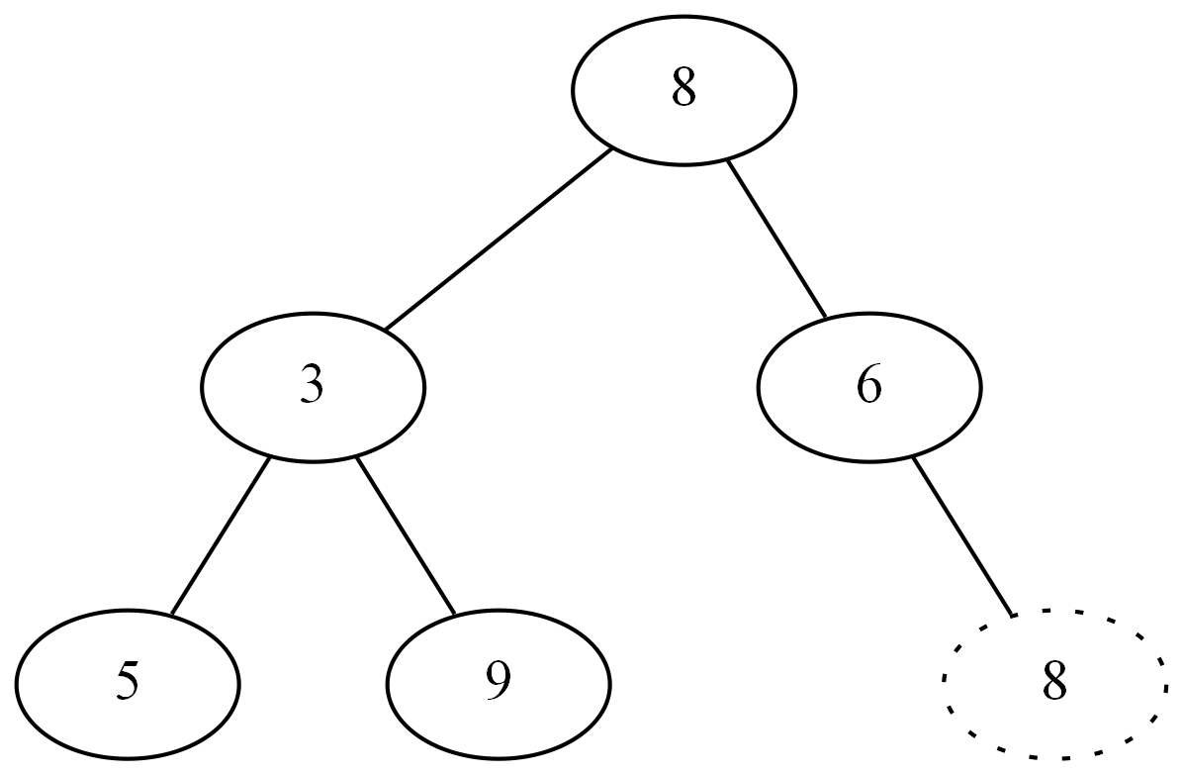
Example 2 – Removing the root

Slide 17
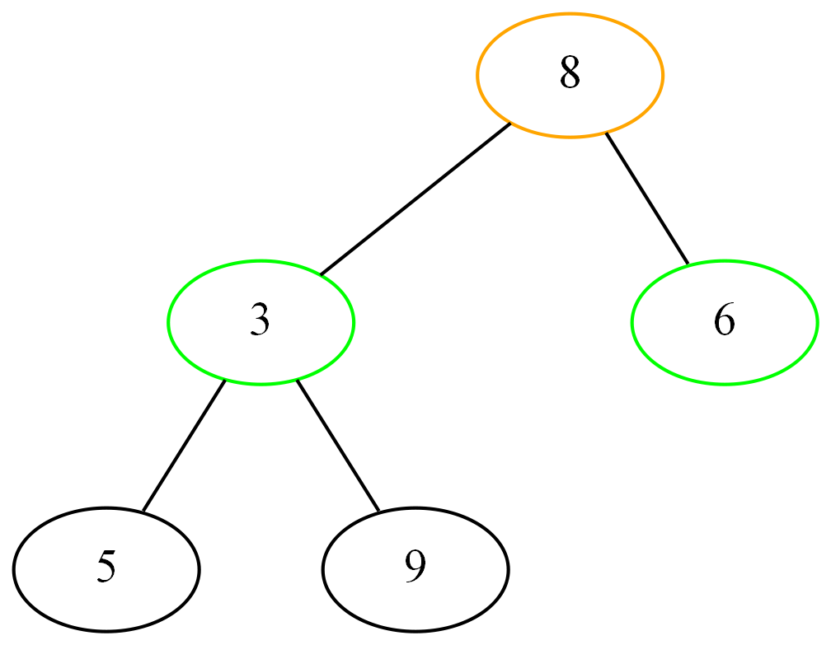
Example 2 – Removing the root

Slide 18
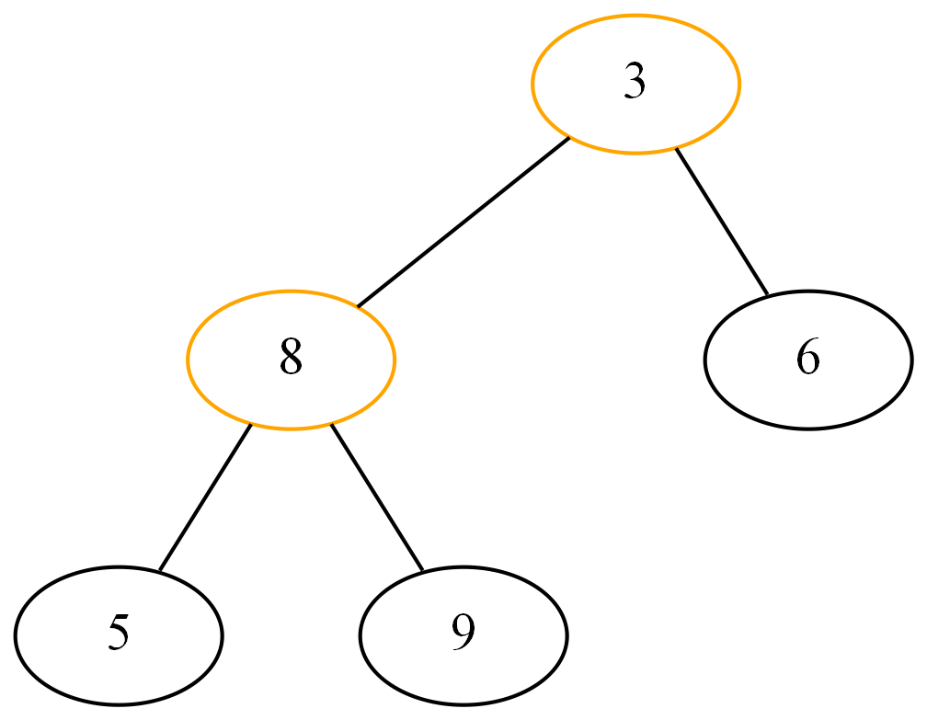
Example 2 – Removing the root

Slide 19
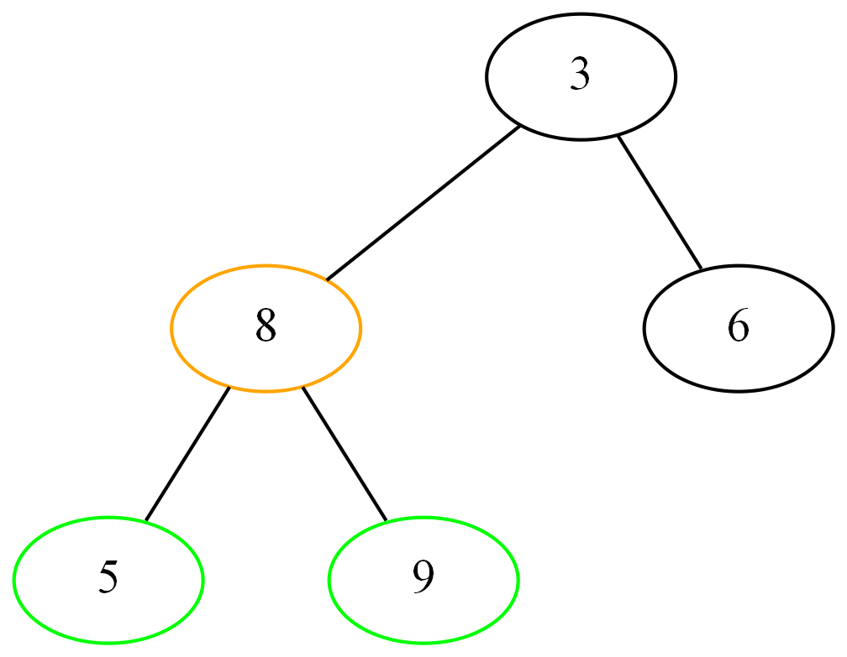
Example 2 – Removing the root

Slide 20
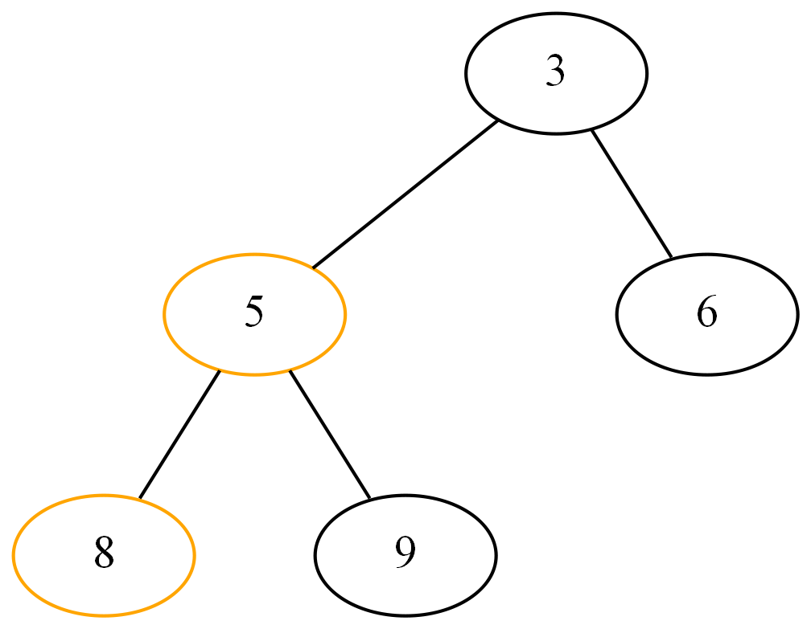
Example 2 – Removing the root

Slide 21
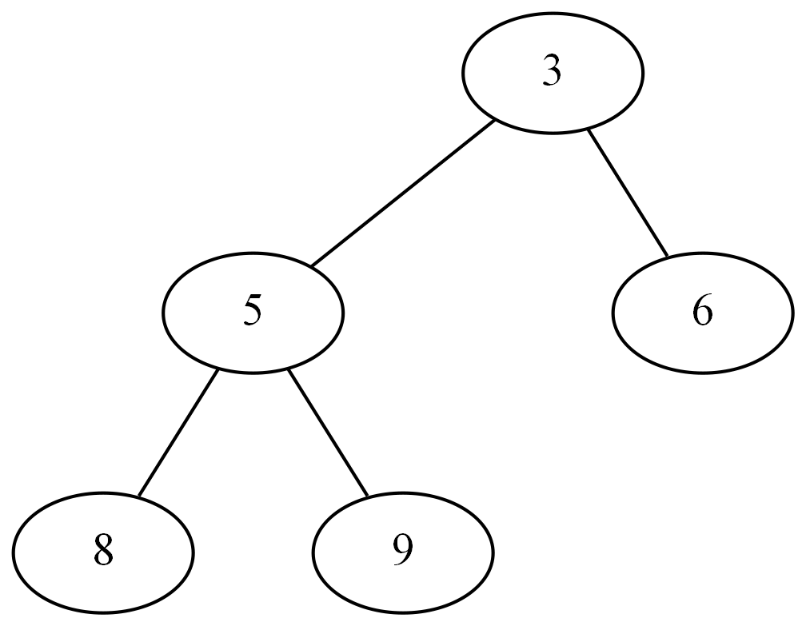
Example 2 – Removing the root

Slide 22
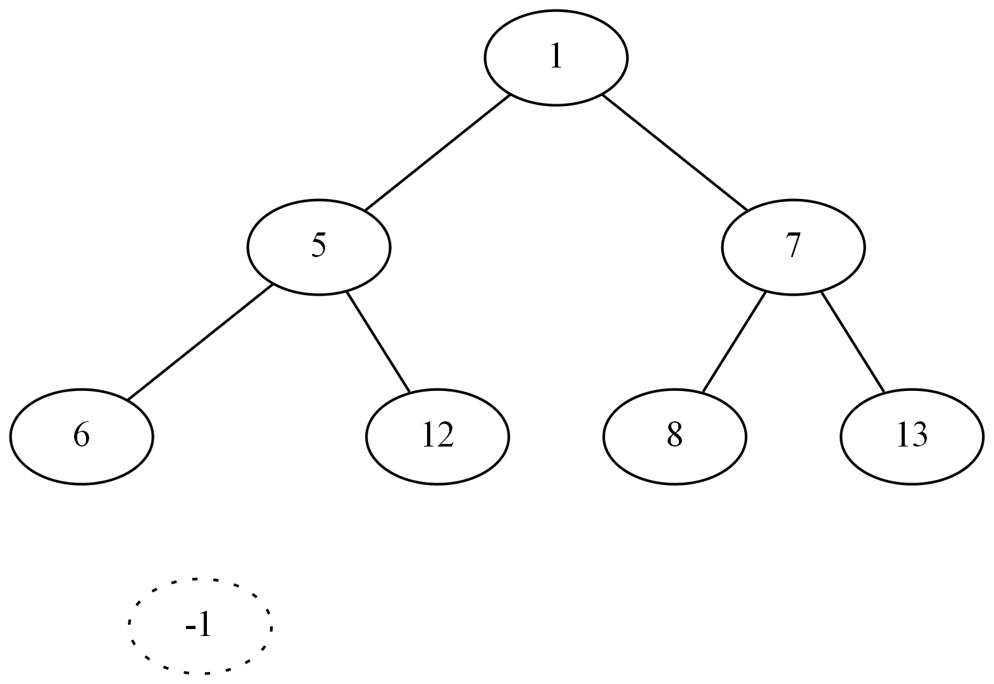
Exercises – Insert

Slide 23
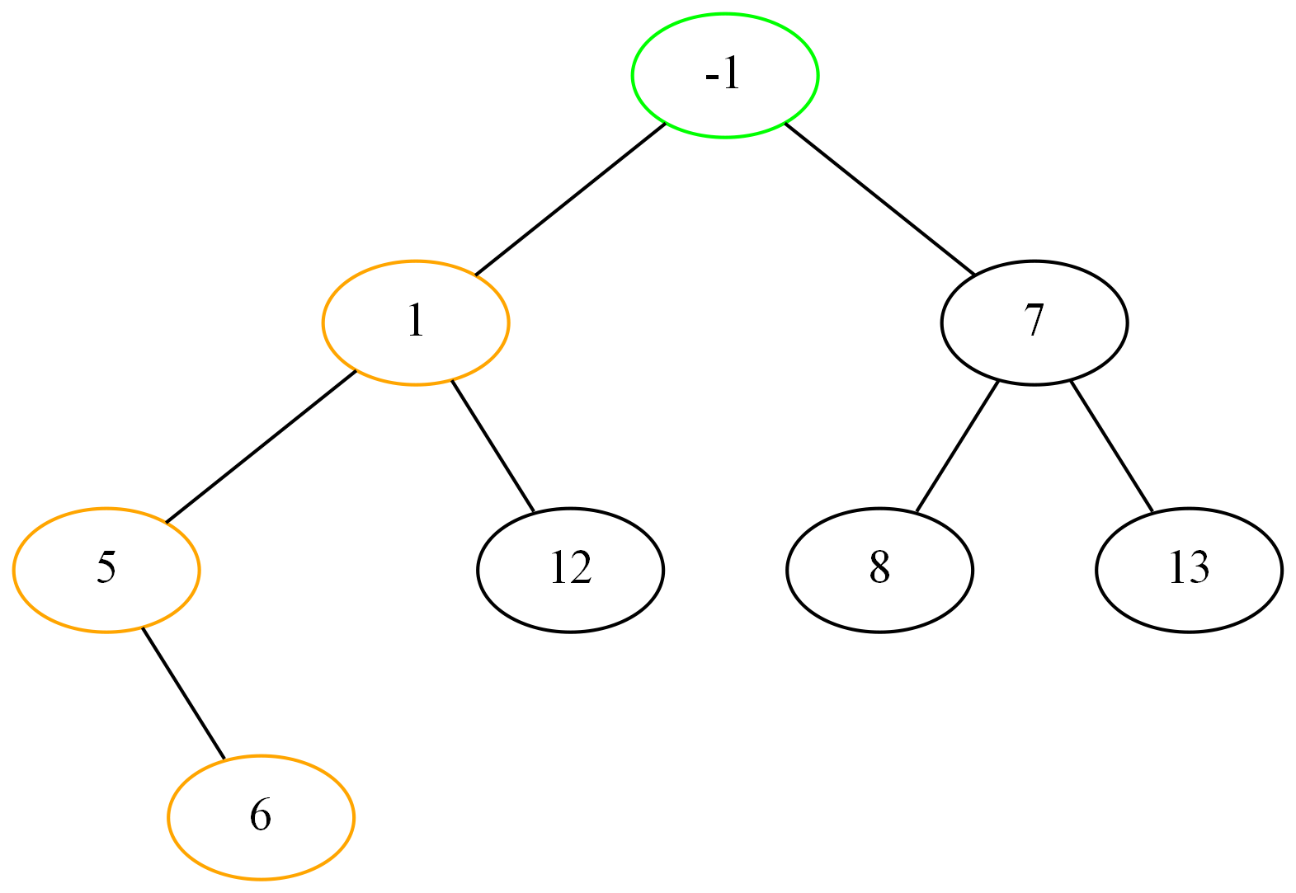
Exercises – Insert

Slide 24
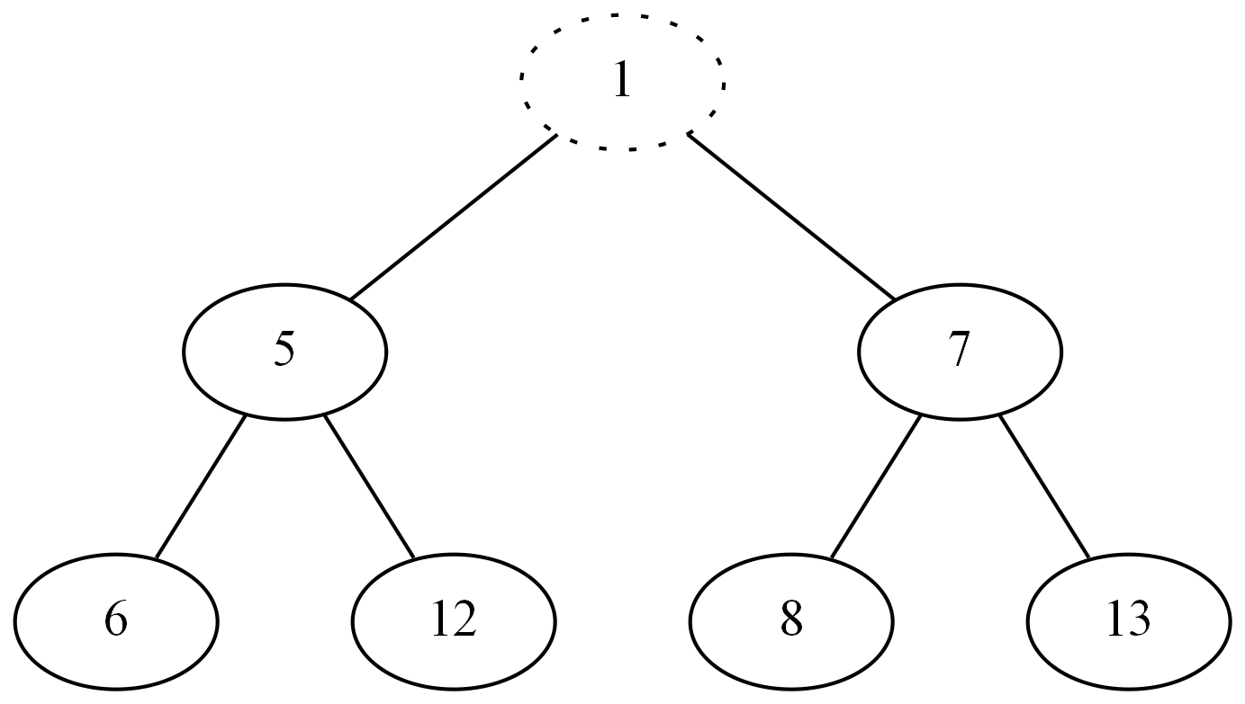
Exercises – Remove Min

Slide 25
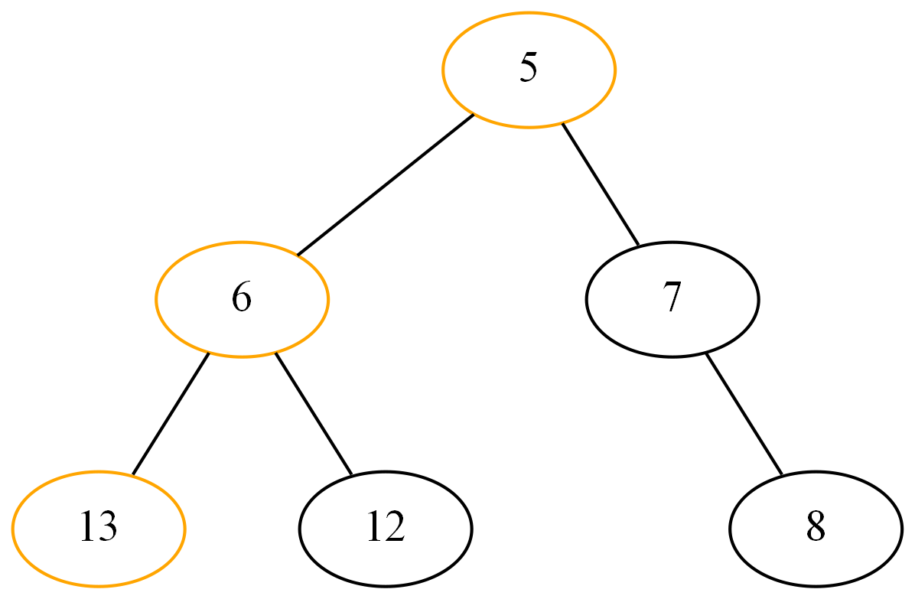
Exercises – Remove Min

Slide 26
Code
class BinaryHeap
{
public:
BinaryHeap(int size)
: m_Capactity(size)
, m_Count(0)
{
m_Data = new int[size];
}
int GetParent(int i) { return (i - 1) / 2; }
int GetLeft(int i) { return (2 * i + 1); }
int GetRight(int i) { return (2 * i + 2); }
int ExtactMin();
int GetMin() { return m_Data[0]; }
void DeleteAtIndex(int i);
void InsertValue(int value);
private:
void Heapify(int);
void swap(int *x, int *y)
{
int temp = *x;
*x = *y;
*y = temp;
}
BinaryHeap() = delete;
int m_Capactity = 0;
int m_Count = 0;
int* m_Data;
};

Slide 27
Code
void BinaryHeap::InsertValue(int value)
{
if (m_Capactity == m_Count)
{
// heap full
return;
}
// Add Value at end
int index = m_Count;
m_Count++;
m_Data[index] = value;
int parentIndex = GetParent(index);
while (index != 0 && m_Data[parentIndex] > m_Data[index])
{
swap(&m_Data[index], &m_Data[parentIndex]);
index = parentIndex;
parentIndex = GetParent(index);
}
}

Slide 28
Code
int BinaryHeap::ExtactMin()
{
if (m_Count == 0)
{
return INT_MAX;
}
if (m_Count == 1)
{
m_Count = 0;
return m_Data[0];
}
int root = m_Data[0];
m_Data[0] = m_Data[m_Count - 1];
m_Count--;
Heapify(0);
return root;
}
void BinaryHeap::Heapify(int index)
{
int leftIndex = GetLeft(index);
int rightIndex = GetRight(index);
int smallestIndex = index;
if (leftIndex < m_Count && m_Data[leftIndex] < m_Data[smallestIndex])
smallestIndex = leftIndex;
if (rightIndex < m_Count && m_Data[rightIndex] < m_Data[smallestIndex])
smallestIndex = rightIndex;
if (smallestIndex != index)
{
swap(&m_Data[index], &m_Data[smallestIndex]);
Heapify(smallestIndex);
}
}

Slide 29
Links and References
https://www.geeksforgeeks.org/(binary-heap/)/
https://www.cs.cmu.edu/~adamchik/15-121/lectures/Binary%20Heaps/heaps.html
http://btv.melezinek.cz/binary-heap.html (Animated)

